Slide 1
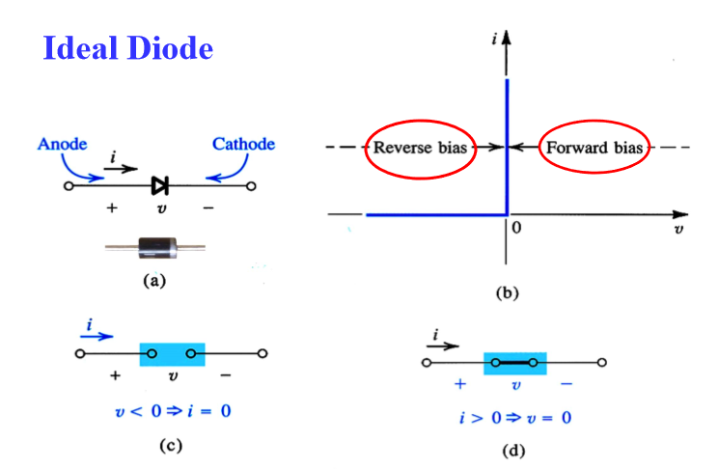
Current–Voltage Characteristic of Ideal Diode

Slide 2
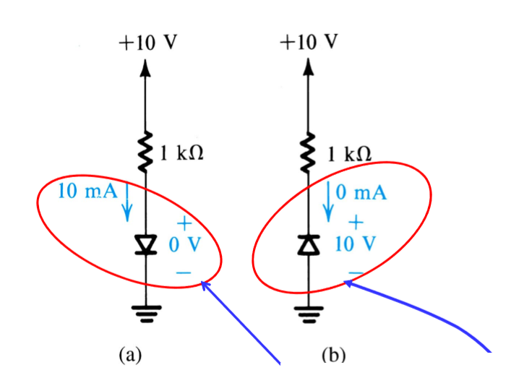
Forward Biased
Reversed biased

Slide 3
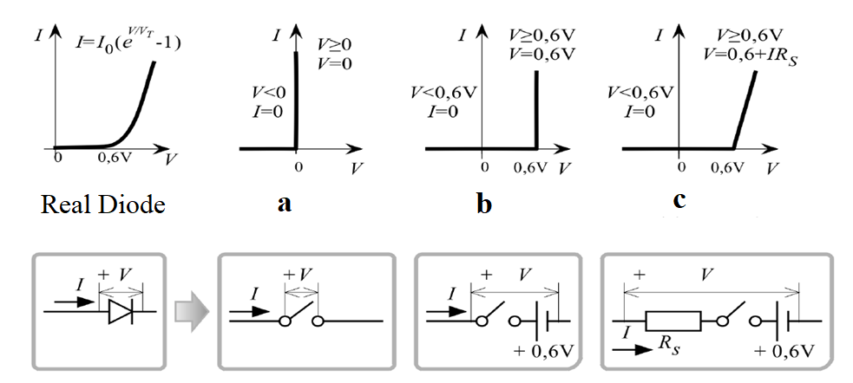



Current–Voltage Characteristic of Diode
Diode is a nonlinear element.
For a:
For b: If , Diode is ON
For c:

Slide 4
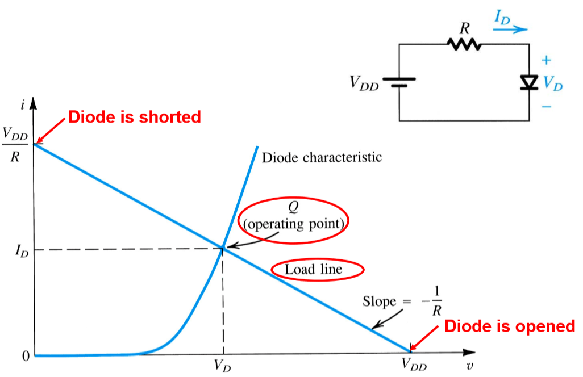
Exponential Model and Load Line of Diode

Slide 5
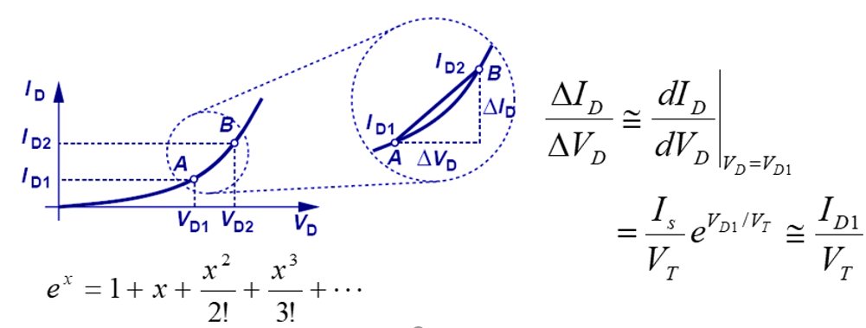
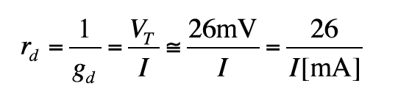
Small signal model of the diode
The dynamic resistance of the diode is also the opposite of this conductivity.

Slide 6

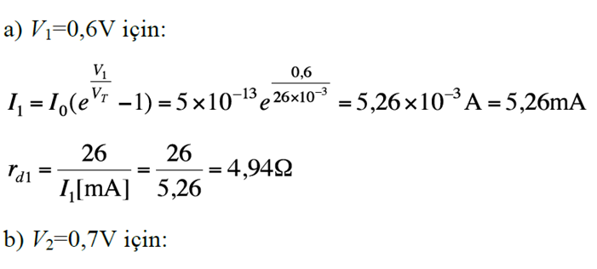
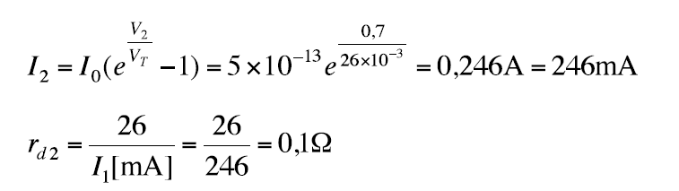
Question: It is given as the saturation current of a silicon diode as .
When 0.6V and 0.7V are applied to the terminals of the diode respectively, calculate the current that will pass through and the dynamic resistance of the diode for these voltages.

Slide 7
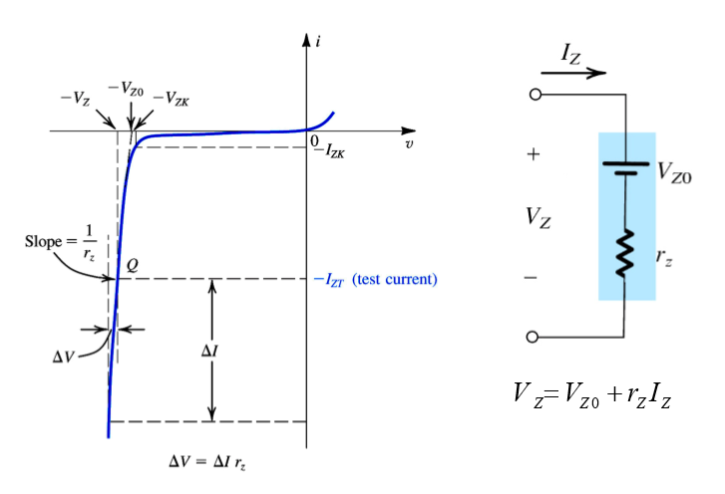
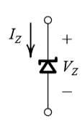
Zener Diode
Circuit Symbol
Current-voltage characteristic for Breakdown Region

Slide 8
Usage Areas of Zener Diode
Used to provide a constant reference voltage.
Voltage stabilization
Signal clipping (signal reduction)

Slide 9
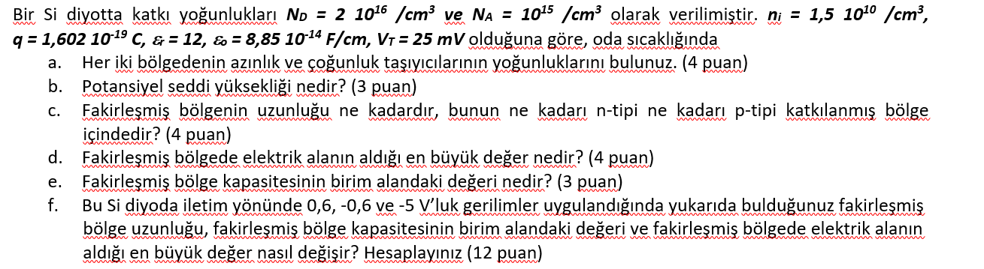
SORU

Slide 10
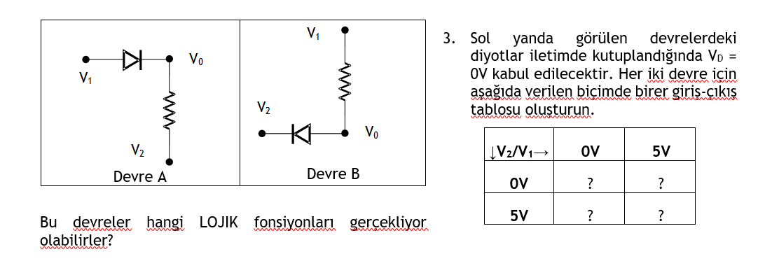
SORU

Slide 11
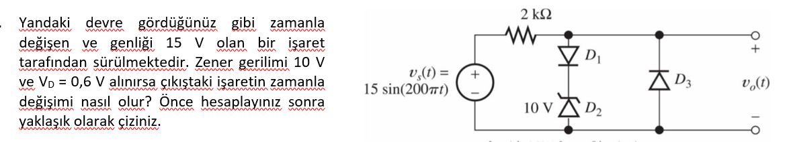
Soru

Slide 12
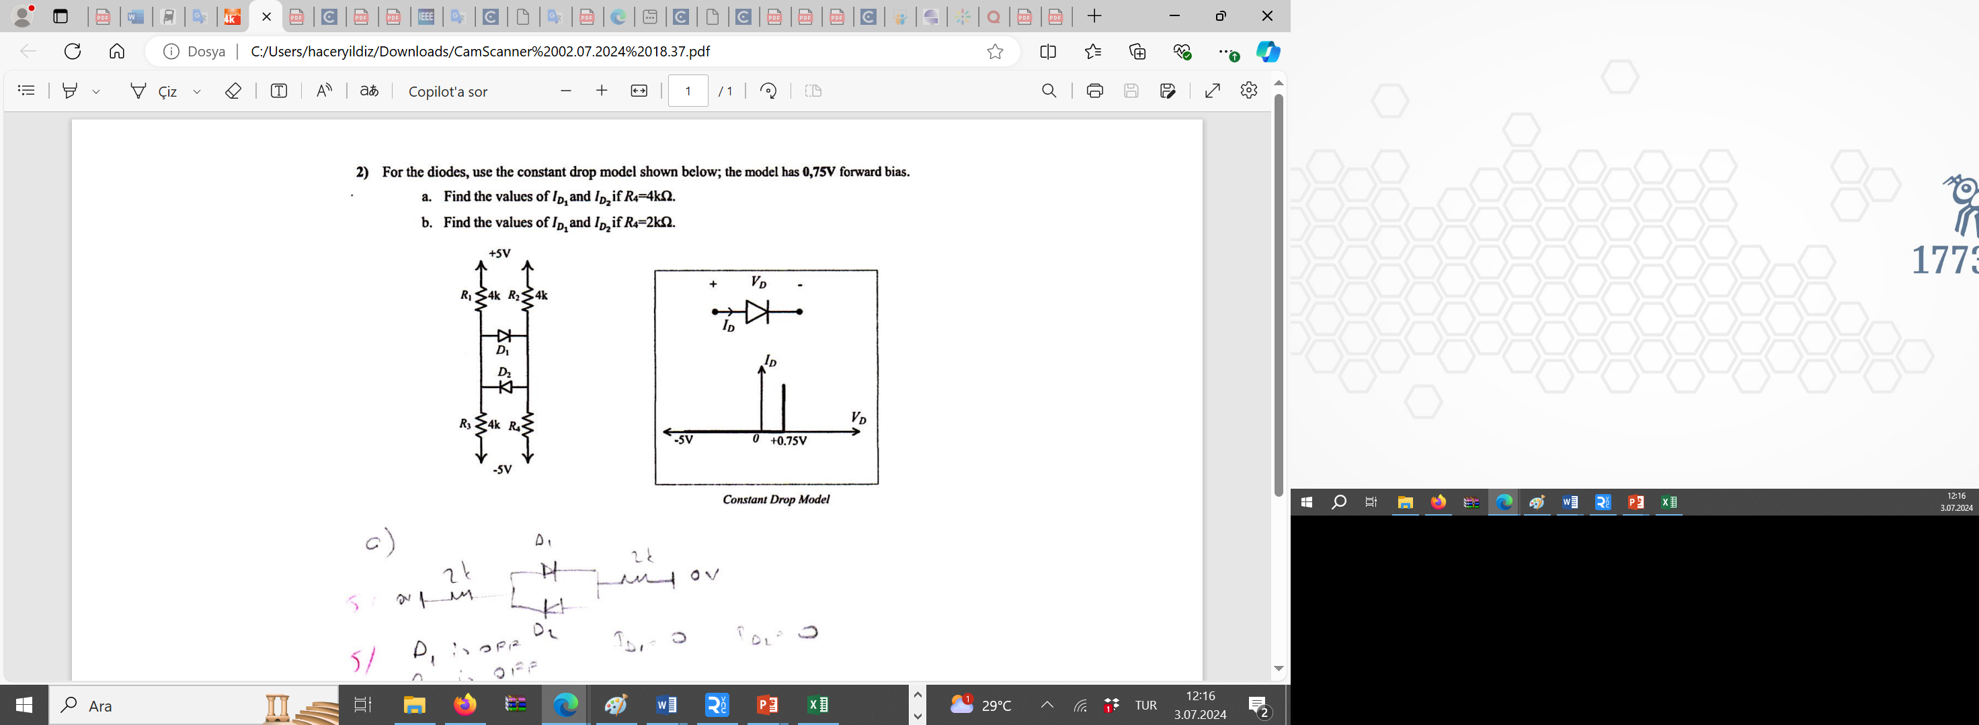

Slide 13
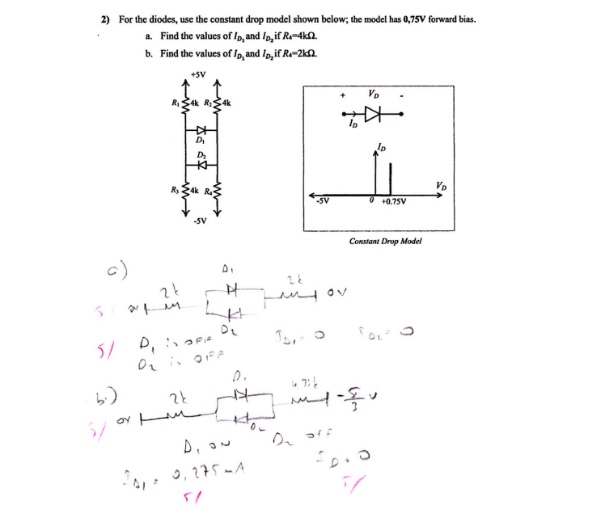

Slide 14
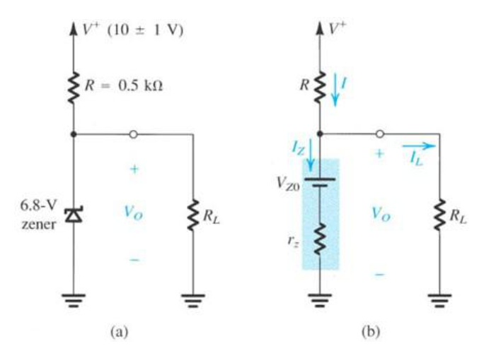
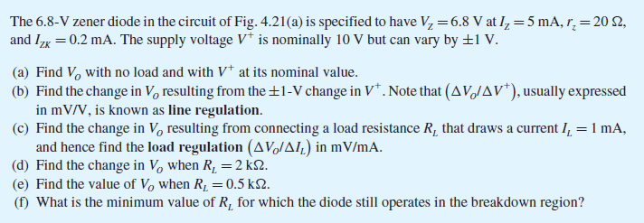
Soru

Slide 15
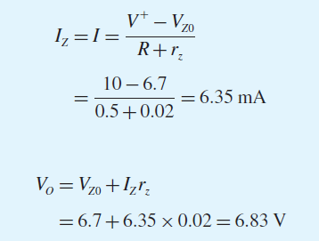
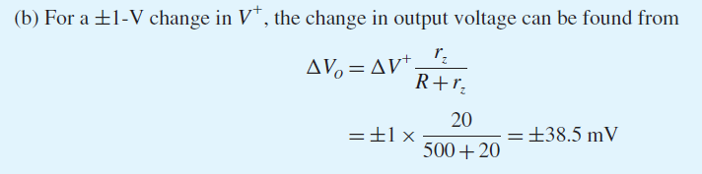






Çözüm
a)
c)
d)
e)

Slide 16
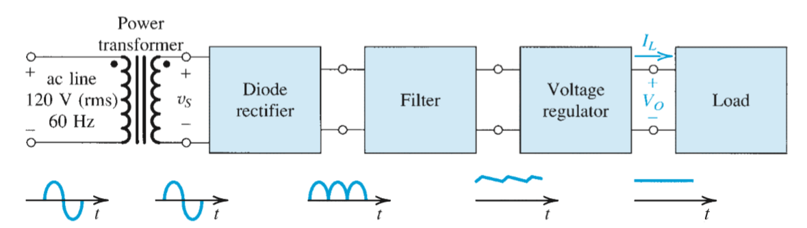
Rectifier Circuits
Block Diagram of DC Power Supply

Slide 17
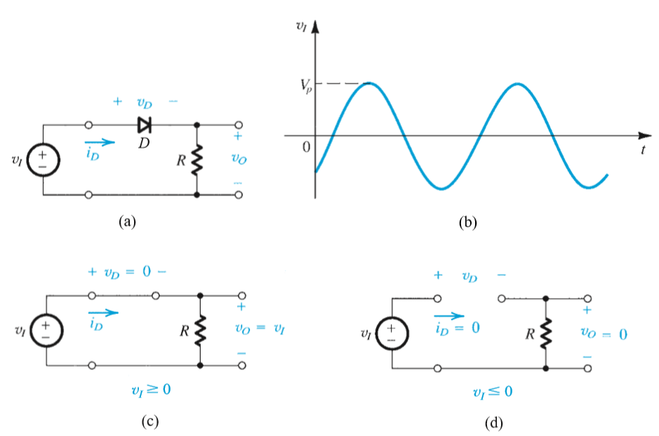
Half Wave Rectifier

Slide 18
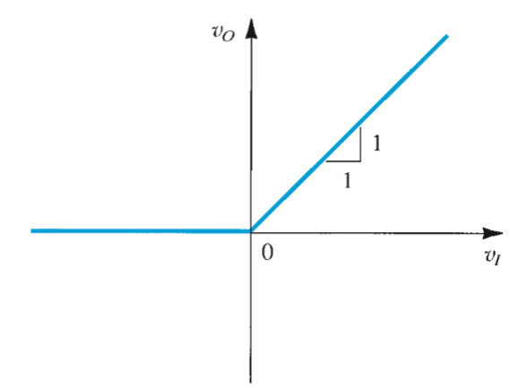
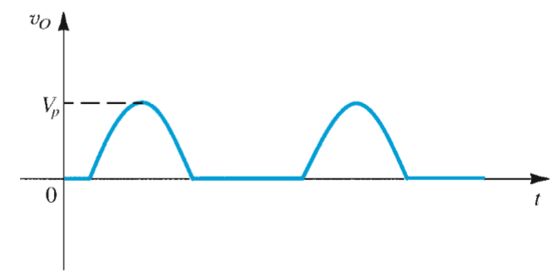

Rectifier Circuit
Transfer Characteristics

Slide 19
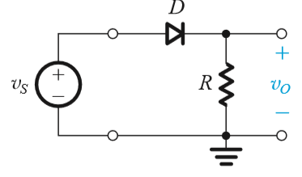
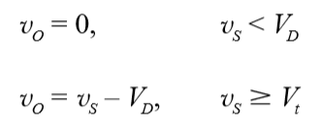
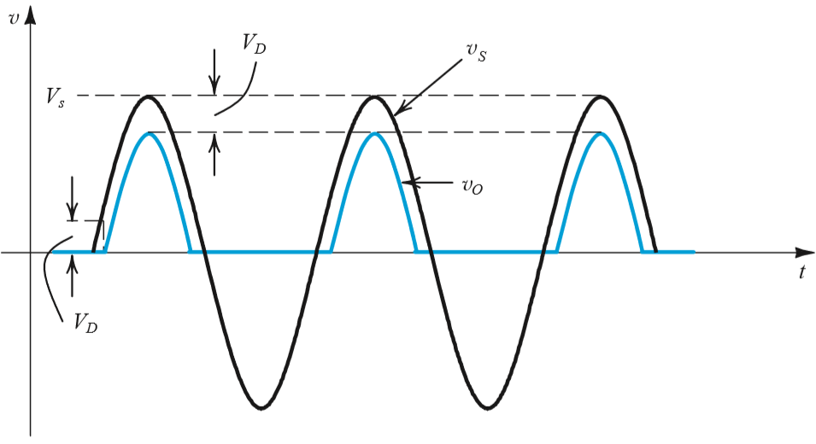
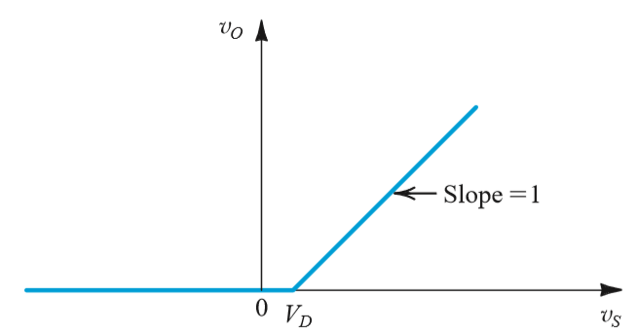
Half Wave Rectifier
Half Wave Rectifier
Transfer function of the rectifier circuit
Input and Output Waveform

Slide 20
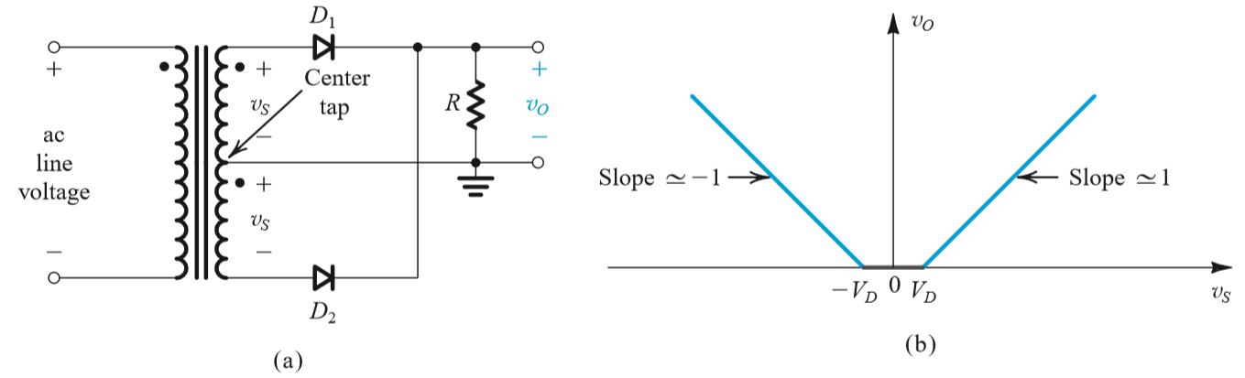
Full Wave Rectifier
Circuit
Transfer Characteristics

Slide 21
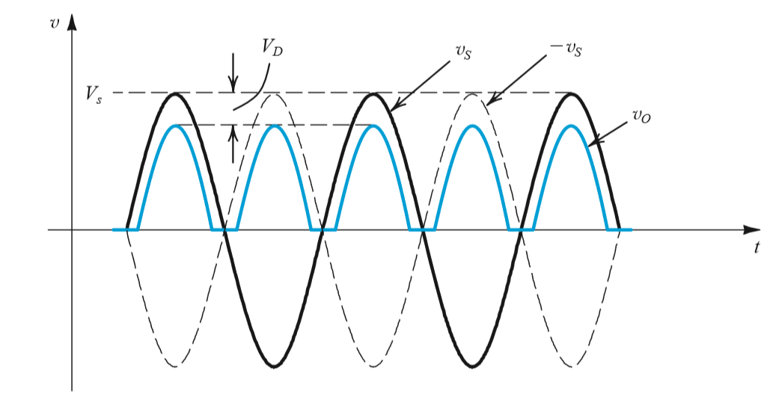
Full Wave Rectifier
Input-Output Waveforms

Slide 22
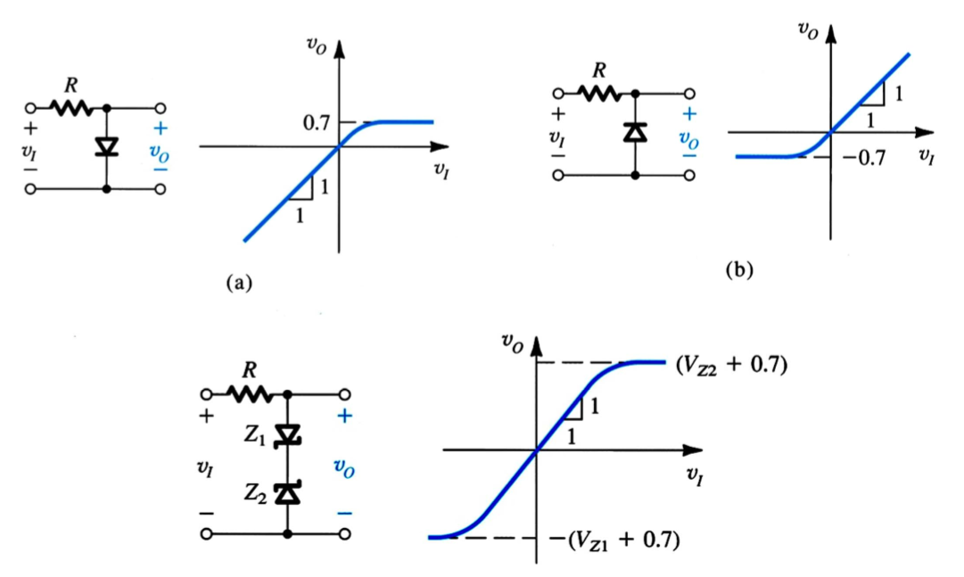

Basic Clipping Circuits

Slide 23
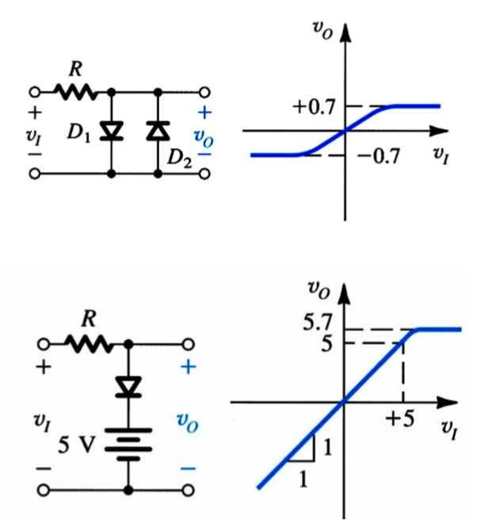
Basic Clipping Circuits

Slide 24
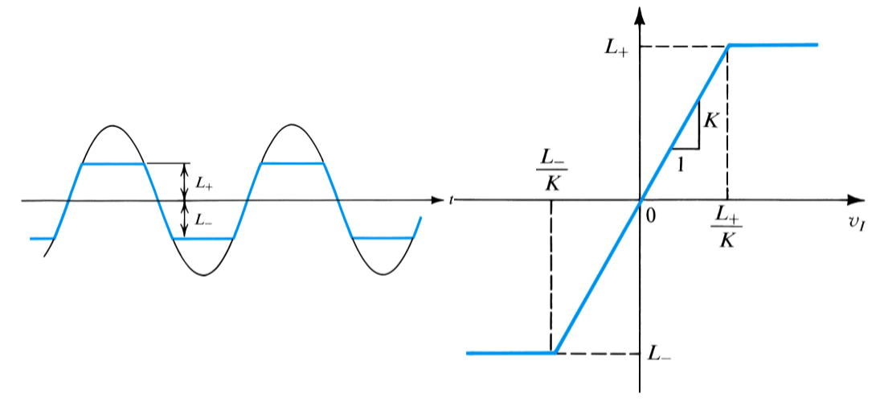
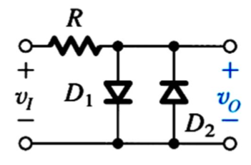
Basic Clipping Circuits

Slide 25
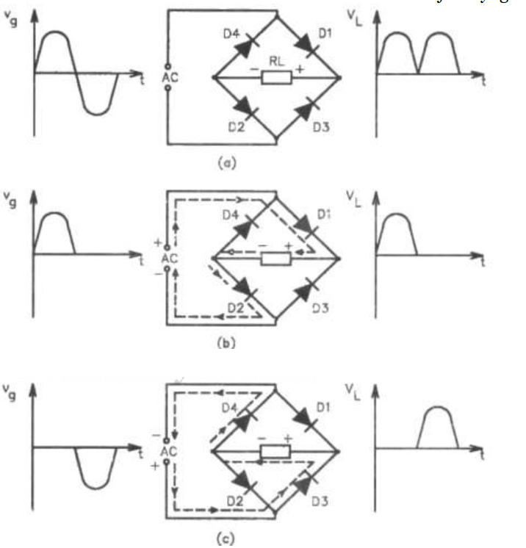
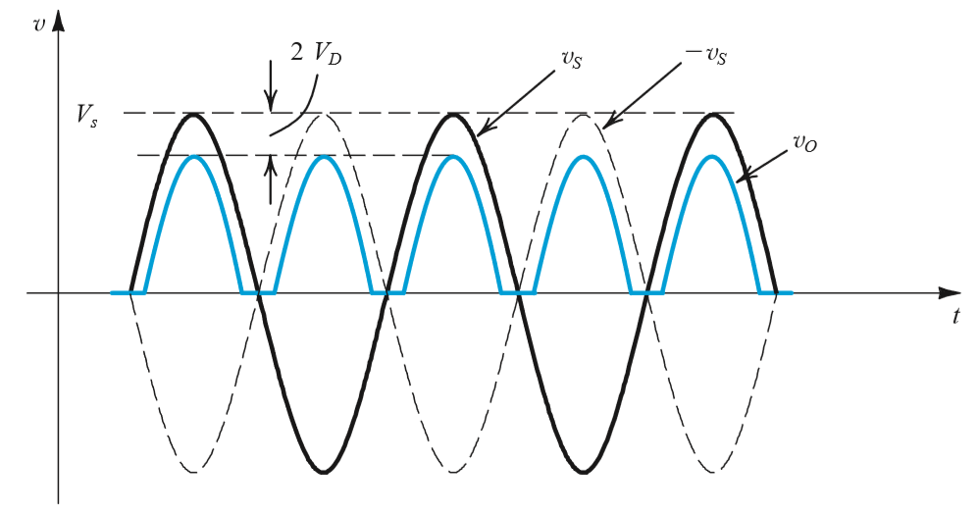
Bridge Rectifier Circuit

Slide 26
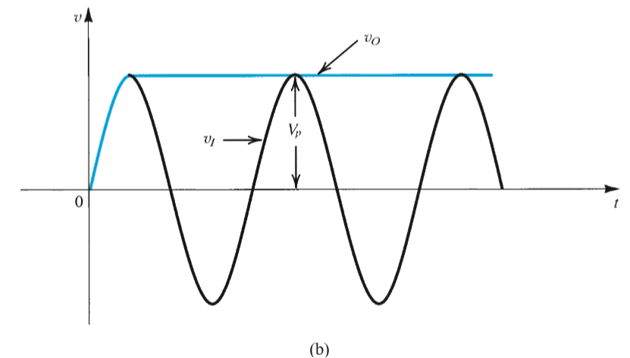
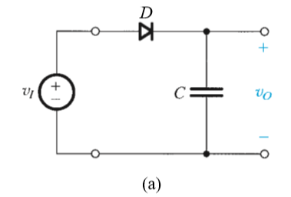

Slide 27
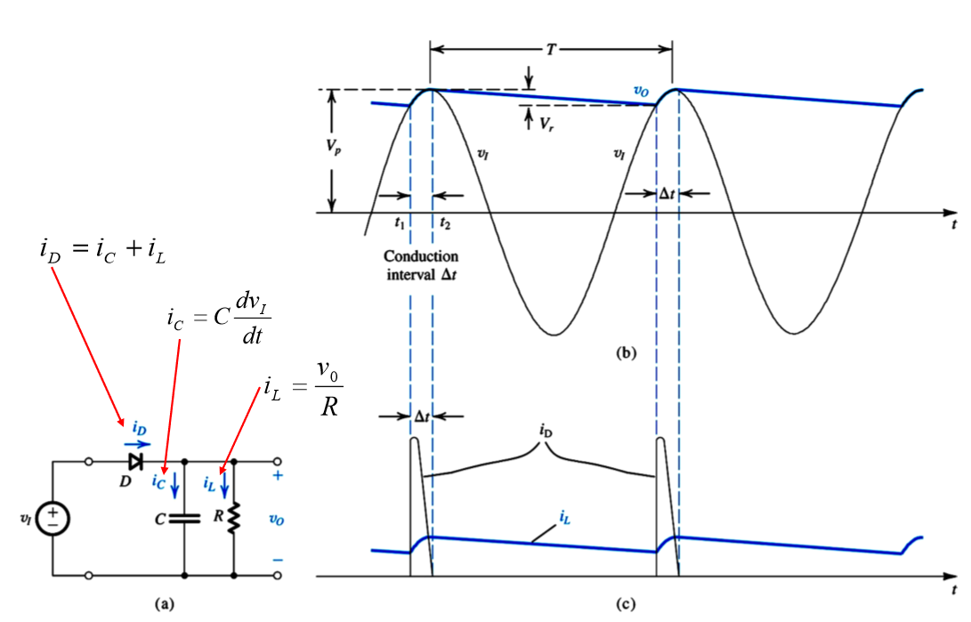
Full Wave Rectifier

Slide 28

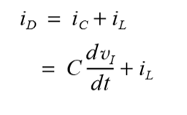
Full Wave Rectifier
T is period of the input signal and the assumption CR >> T, the following relations can be obtained:
When the diode is ON:

Slide 29
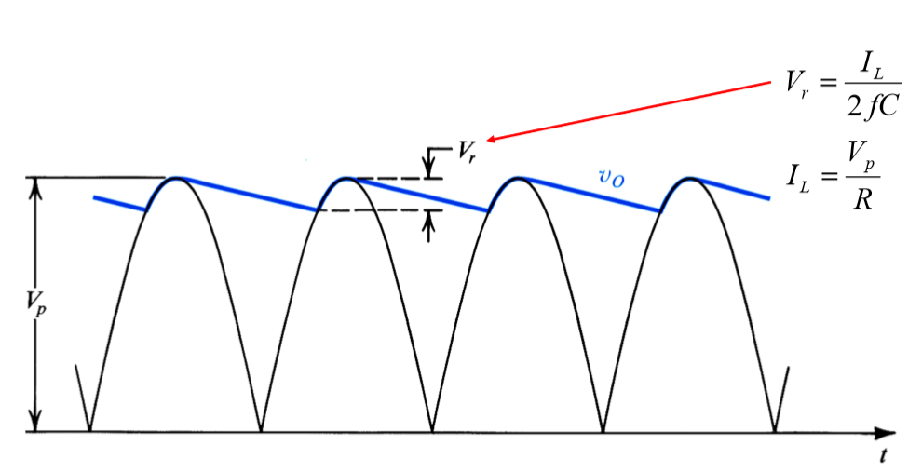
Full Wave Rectifier
We use a filter circuit as shown above to convert AC voltage to DC voltage. During the positive half-wave, the diode D is ON . The capacitor is unloaded and when we apply AC voltage, the capacitor fills up to the maximum value of the input voltage.
At this point, the supply voltage is equal to the capacity voltage.
In the negative half wave, the diode is OFF and the capacity begins to discharge over the R load.
The capacitor begins to discharge gradually, this is slow compared to the charge of the capacitor. It does not take enough time to fully discharge and charging begins again.

Slide 30
Question
The diodes given in the figure below are identical and VD = 0.6 V. Accordingly, find the value of the ID current and V0 voltage for each circuit.

Slide 31
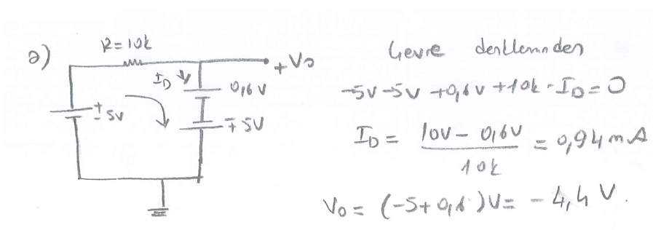
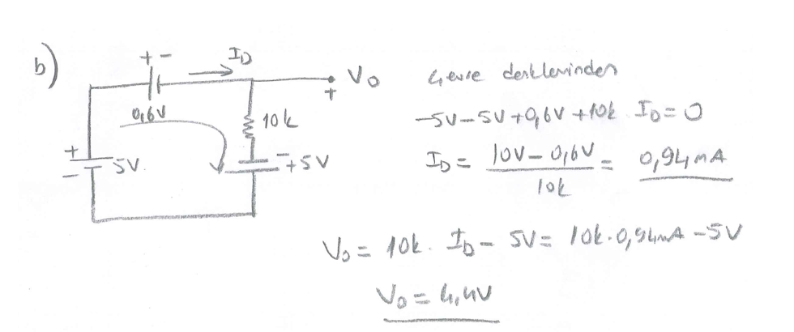

Slide 32
